Slide 1
Y11 Preparing for
Success Evening

Slide 2
Mr. James Graham
Principal

Slide 3
Our Mission Statement
At Aston Academy we are committed to providing high quality learning and teaching, enabling everyone to reach their full potential, whatever their age, ability, gender or ethnicity.
We believe that every person is unique and we work together in an inclusive environment of mutual respect and consideration, valuing everyone's contribution.
Through our partnership with the local and wider community we aim to support our young people in successfully taking their place in society.
All adults in school have a responsibility to safeguard and promote the welfare of children.
With your commitment we will make a difference.

Slide 4
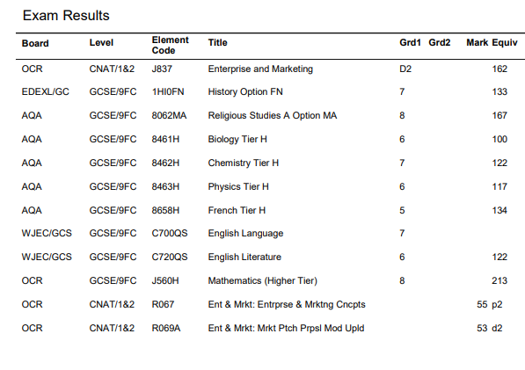
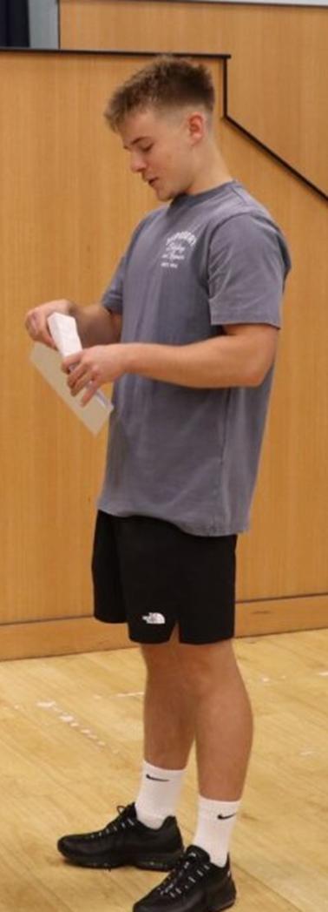
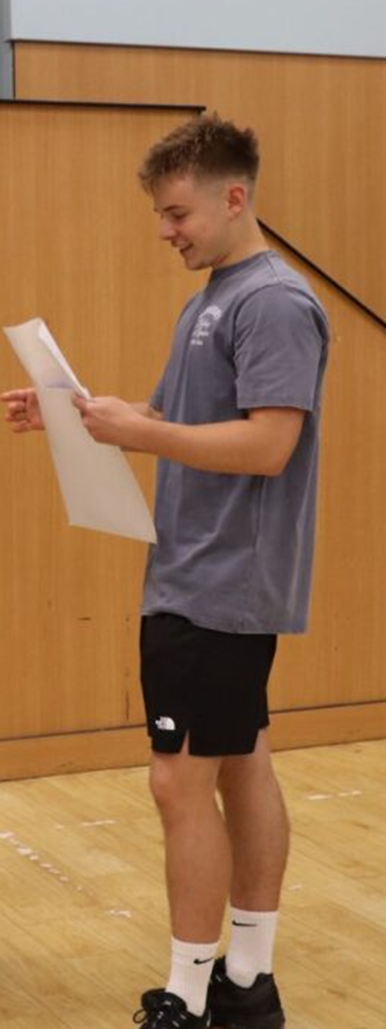
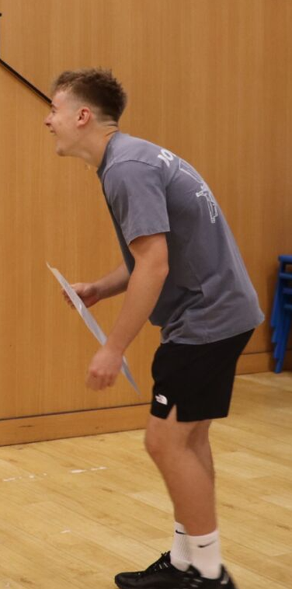


August result collection…
Resilience
Pride
Respect
Ambition
Responsibility
Vision – Be Exceptional

Slide 5
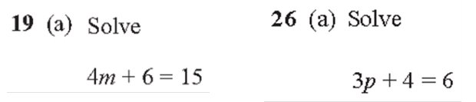
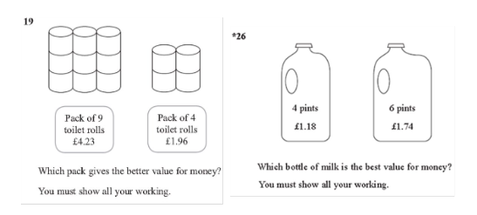
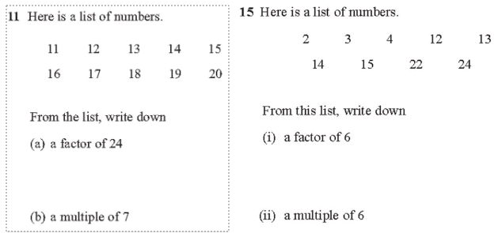
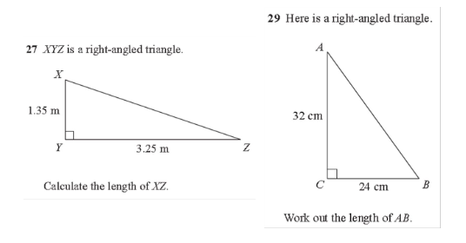
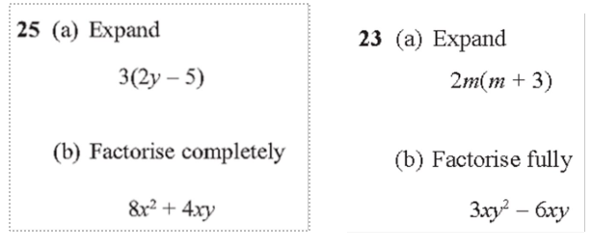
We need to focus on exam practice

Slide 6
Key Dates
Date | Event
25 September | Construction NEA deadline
16–17 October | Language Speaking Exam (Trials)
3 November | November Trial Exams begin
26 November | Colleges Event
19 January | Language Speaking Trials 2
9 February | February Trial Exams begin
4 May | GCSE Exams begin
26 June | Last scheduled GCSE Exam
9 July | Prom – Magna Science & Adventure Centre

Slide 7
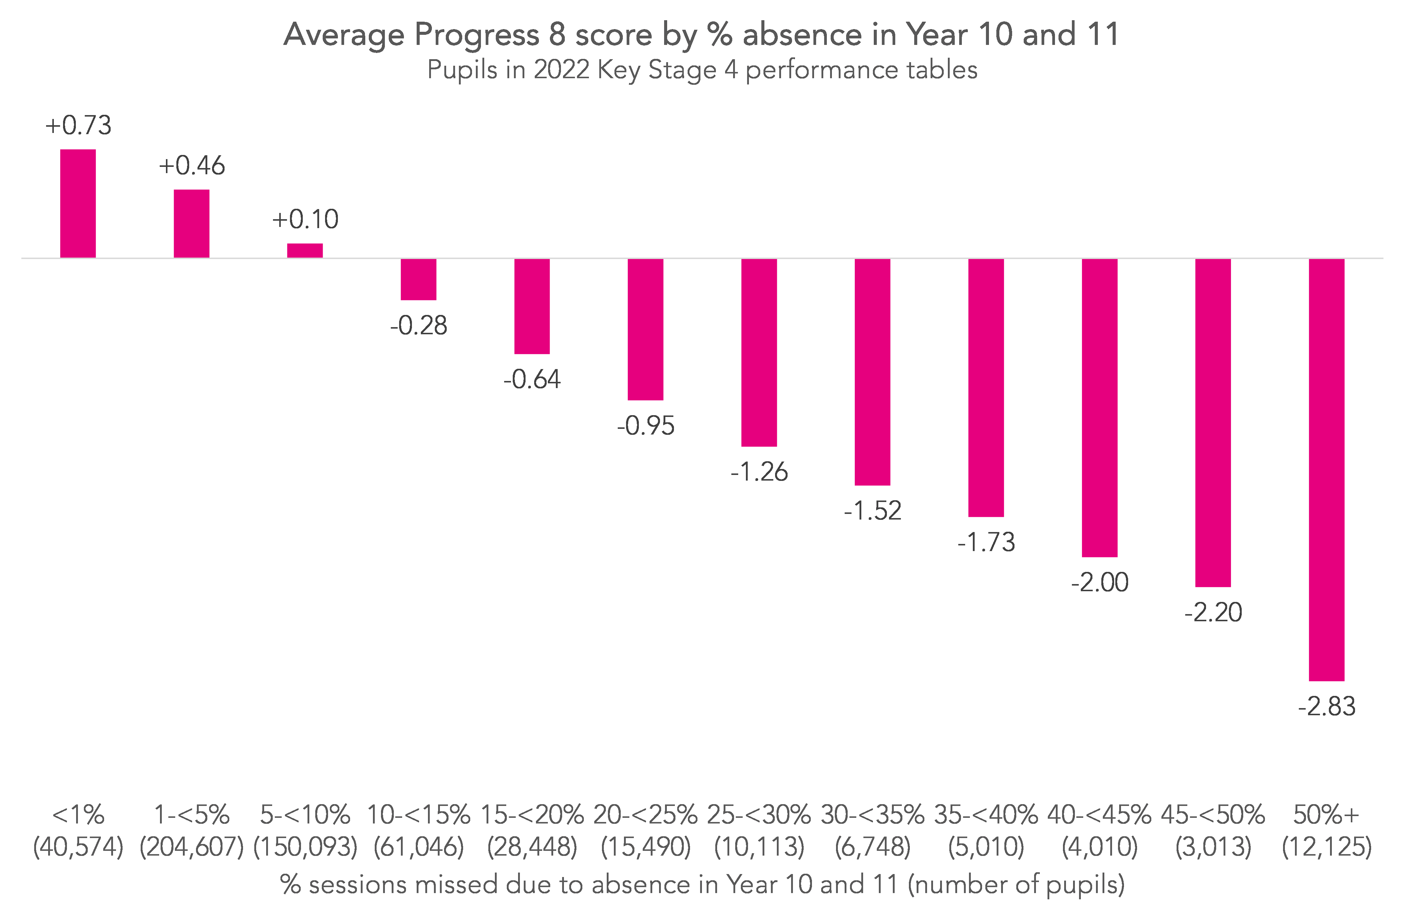
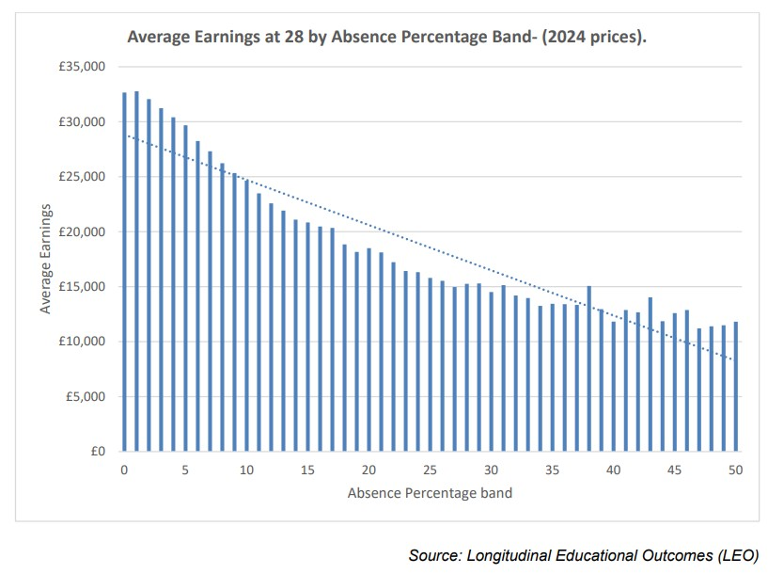
Attendance

Slide 8
Attendance -GRU
95 %+ (about 1 day off every 8 school weeks)
81 % pass Grade 4, 58 % pass Grade 5 in English & Maths.
91–95 % attendance (1 day off every 5–6 weeks).
Pass rates fall to 65 % (Grade 4) and 47 % (Grade 5).
85 or less attendance (around 1.5 days off every 2 weeks).
Only 27 % achieve Grade 4
Attendance band | % Passing English and Maths (Grade 4) | % Passing English and Maths (Grade 5)
95% and higher | 81% | 58%
91% to 95% | 65% | 47%
90% to 91% | 50% | 33%
85% to 90% | 35% | 26%
Less than 85% | 27% | 14%

Slide 9
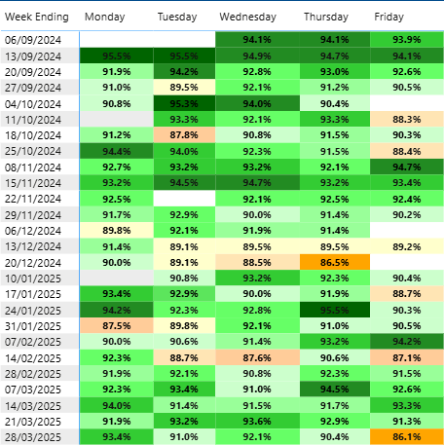
Strong beginnings
Fridays
Before Christmas holidays
Week before half term
Last day of term

Slide 10

Student wellbeing
Making sure that your child is ready for learning is essential to helping them to achieve their best in school.
Healthy diet
Staying hydrated
Exercise
Getting enough sleep
Mobile phone use before bed
Hobbies

Slide 11
Tips for supporting with revision
Ensure students put their phone away.
Establish a routine; they should use the same times each evening and weekends to revise. They are more likely to stick to routines
Timing, work around their commitments, don’t give up hobbies.
Most research says work for about 30 - 45 minutes and then have a 5-10 minute break.
Encourage them to start early. It takes time to commit things to memory- interleaving.
Spread out revision, is it more effective to do small chunks and keep revisiting a subject than to spend a whole day on the same subject.
Ensure they allow time to relax.

Slide 12
Creating the right revision environment
Should be calm and quiet
Well lit- natural light is best
A tidy desk with all the necessary equipment (post it notes and revision/flash cards are key).
Water and snacks handy
Free from distractions

Slide 13
Resources
Class notes/ books
Google classroom
Revision sessions
Easter revision school
Text Books
Exam questions – Physics and Maths Tutor
https://www.physicsandmathstutor.com/past-papers/

Slide 14

Resources
English = Eduqas
Maths = OCR
Science = AQA
French/ Spanish = AQA
Geography = AQA
History = Edexcel
PE = Pearson
RE = AQA
Fine Art and Photography = AQA
3D Textile Design = AQA
Computer Science = OCR
Design Technology = Eduqas
Health and Social Care = OCR
Sociology = AQA
Hospitality and Catering = Eduqas
Drama = AQA
Know your specs;
Subject Information
Year 11 Suggested Revision Resources.docx

Slide 15
Managing Emotions
Anxiety and stress v's nerves
Be a listening ear
Keep calm
Divert attention
Encourage them

Slide 16
Student voice

Slide 17

Student wellbeing
Student Mental health at Aston is really important to us. We are here to support your child in school.
Pastoral Team
Support from the inclusion team
CAMHs referral
MIND referral

Slide 18

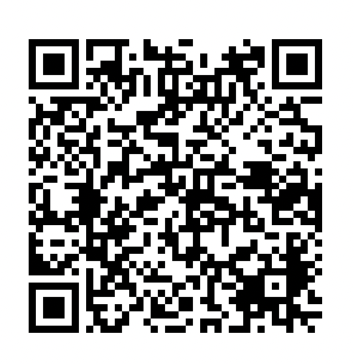
Y11 Team
Mrs Debbie Adams
Assistant Vice Principal – Personal Development
Mr Giorgio Rubbo
Pastoral and Learning Lead for Year 11
Miss Katie Birks
Learning and Progress Manager
Contact us:
aa-y11leadershipteam@astonacademy.org

Slide 19
Period 6, Tutor and Enrichment
Supervised study is Tuesday and Thursday 3-4 in the sixth form common room
Taught Period 6 is free tuition and will start after October Half Term
Additional, above and beyond the curriculum
Last year, students who attended P6 consistently achieved on average a quarter of a grade more than their counterparts who did not attend. This meant the difference in many cases between grades.
Tutor groups are based on Science attainment- this is to support academic progress in science and with application-based maths skills
Enrichment activities are just as important – we understand this in many cases clashes with P6
Healthy balance is needed
None of the above replaces or makes up for missed curriculum time– it enriches.

Slide 20
GCSE Exams- Rules and Pitfalls
All "smart" devices are banned from exams – wallets on desks
Any communication with candidates is banned and must be reported to JCQ
Exams are closed 30 minutes from the start time, late candidates cannot enter and will be awarded 0 marks
Any adaptations to exams must be evidenced as students normal way of working
Contingency days are only used if an exam is cancelled at a national level
Missed exams are awarded 0 marks – special consideration requires significant medical evidence

Slide 21
Top Tips for Progress
Ensure that revision is "active" - passive note taking and reading notes doesn't have a measurable impact on attainment
Encourage students to create and stick to a revision timetable
Ensure that the revision environment is calm and effective
Breakfast and healthy snacks during exam season are vital

Slide 22
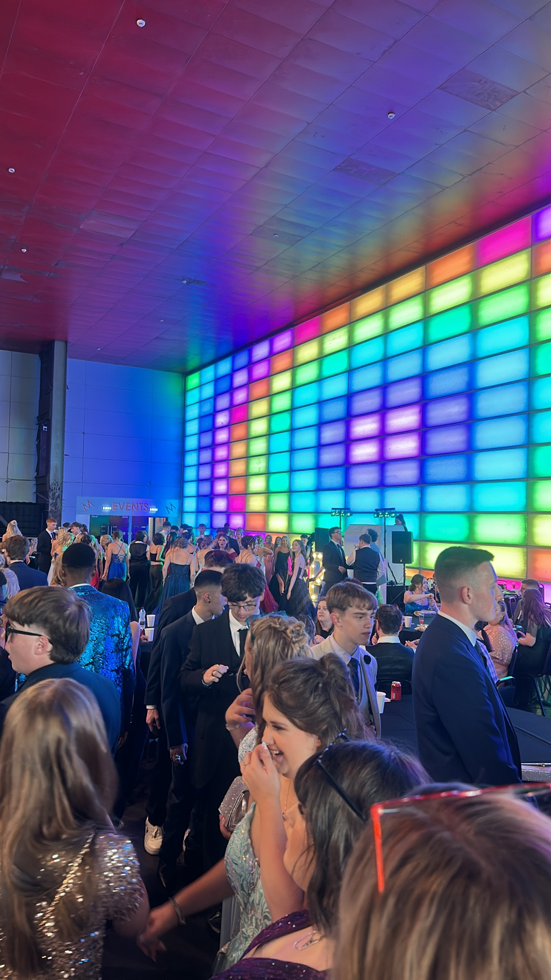
Prom
9th of July 2026
Magna Science and Adventure Centre

Slide 23
Pathway to Prom-
Invitation to the prom is subject to overall attendance to school, attendance to lessons and behaviour.
After half term, your child will either receive an invitation to Prom or a Prom contract.
Prom contracts are reviewed every half term.
Letters home will be sent after half term with the full information.

Slide 24
Pathway to Prom-Requirements
95% Attendance (80% chance of passing English and Maths)*
90% Positive behaviour (Positive engagement = greater progress and less disruption for all)
Less than 15 minutes of late per half term *
No suspensions from school
*Lateness to school/ Absence due to medical appointments is excused from this, appointment evidence must be provided in line with LA attendance guidelines
We reserve the right to withdraw tickets once issued due for incidents of extreme or severe behaviour

Slide 25
Your questions
Are there additional lessons available for certain subjects so children can have more support?
Yes- P6 starts after October half term
Why have some of the teachers changed from Y10 to Y11. Surely keeping the same teacher would be better for the students education?
Timetabling, staff changes and flexible working means that some groups or staff have changed. Y11 are timetabled first, so Heads of Faculty can place the most appropriate staff member on each group
When do they get an exam timetable? Do you offer revision classes and show them ways to revise?
Once JCQ publishes a final exam timetable, and we have confirmed all entries the exams team prepare the final exam timetables. This is usually around the end of april. P6 independent study and tutor will cover revision strategies

Slide 26
Your questions
Will previous exam papers be shared to assist with revision at home?
Past papers are available on exam board websites
Please could you include info on which exam board each subject is using to help us with buying revision guides.
Covered in our presentation tonight – info available on the website and given out.
What’s the current guidance on time spent revising ? I.e. when I was at school it was 50 mins revision, 10 mins break.
40-50 minute chunks with a short break. Students should be working towards completing 1-2 chunks after school, with 5-6 each day at a weekend

Slide 27
Your questions
Every student can book appointments with Mr Shaw the careers adviser who can support this. Applications for post 16 study start in November with open days.
When do they apply for A levels/ Is there careers guidance?
Information about homework and revision. Will it be set by staff? On paper or online? How much should the pupils be doing? When should they start revision etc.
Homework will be set by staff, some faculties (maths, science) use online tools but this is down to the department. Students should begin revising as soon as possible, aiming to peak their revision around 2 months before exams
When will leavers jumpers be distributed?
These will be distributed prior to the first exam
Can mock results be used if we are unhappy with our child's GCSE results?
No – colleges or jobs will request to see official exam documentation of certification to prove your results.

Slide 28

Save the Date
15th October - Year 11 Revision Festival
16.30 to 18.00
Top tips for revision success, resources from subject staff, templates for timetables

Slide 29
Thankyou for your attendance
Wishing our year 11 students and their families all the best for a successful year.

